Slide 1
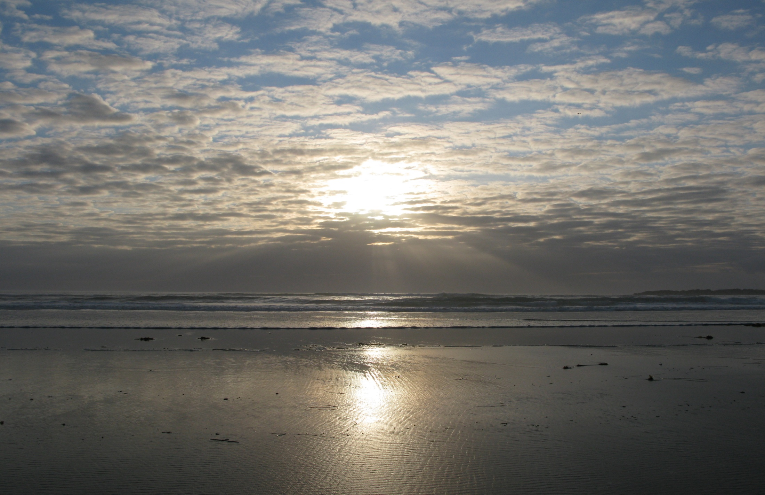
Have a Talk With God
by stevie wonder

Slide 2


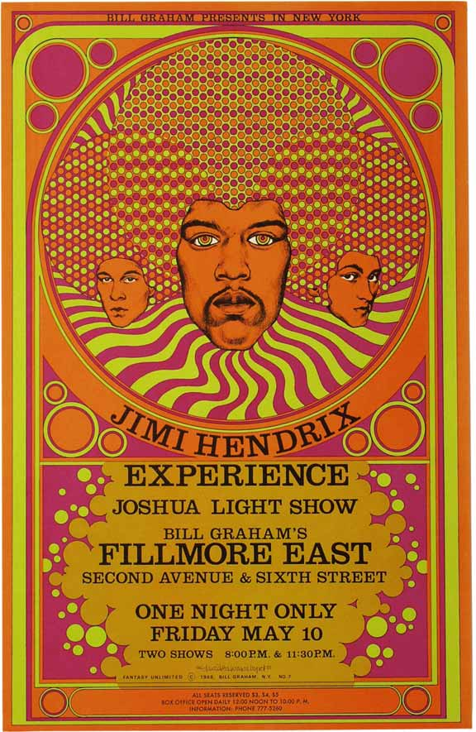
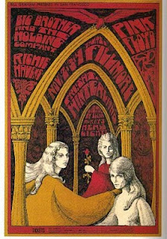


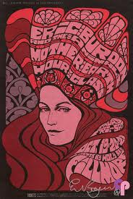

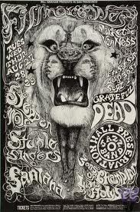
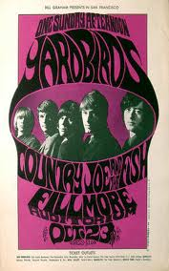



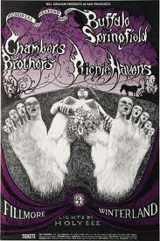
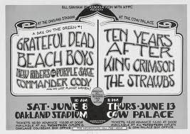
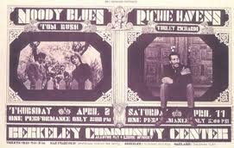

Slide 3
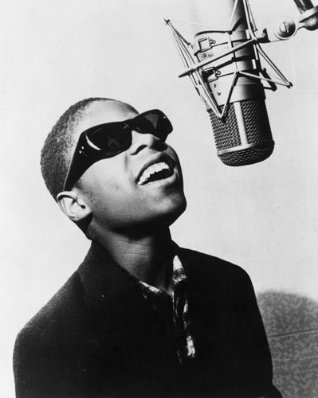
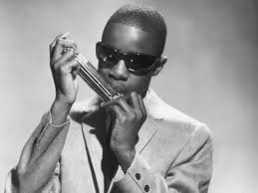

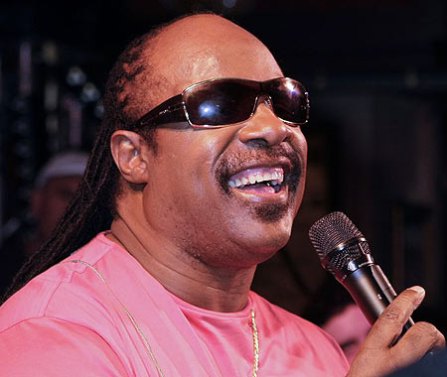
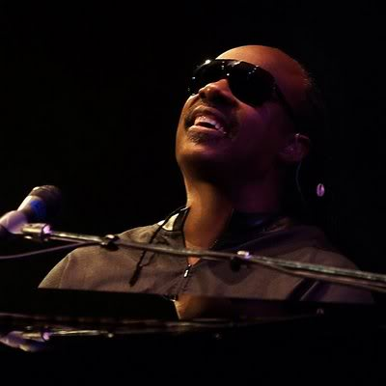

Slide 4

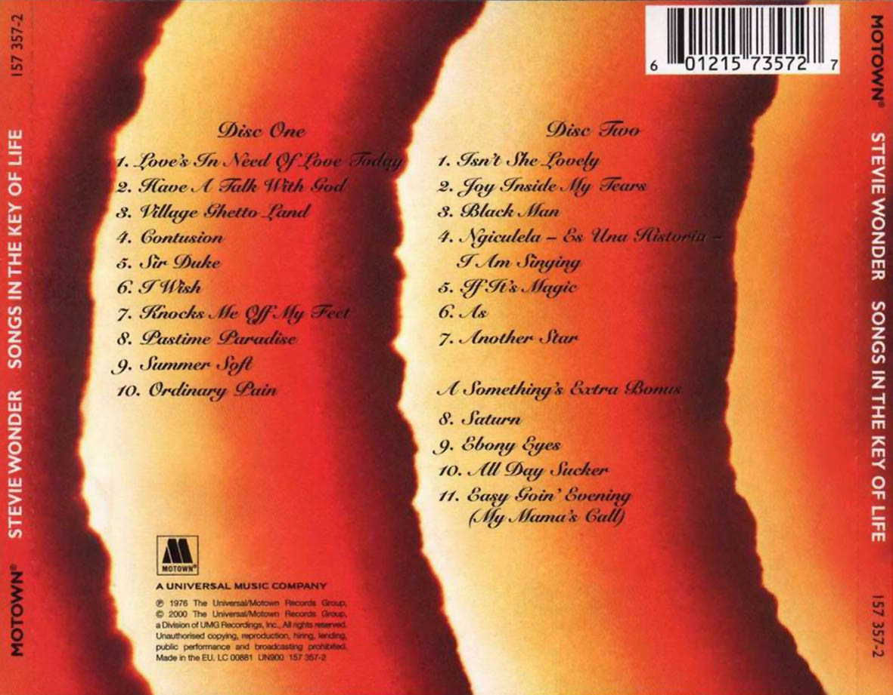

Slide 5
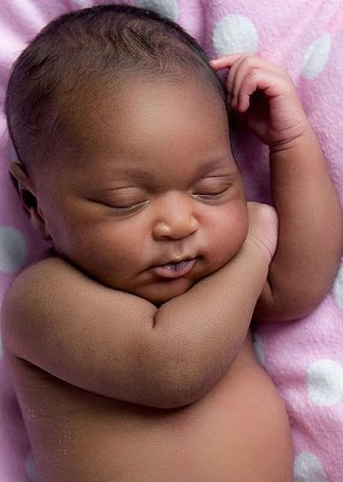

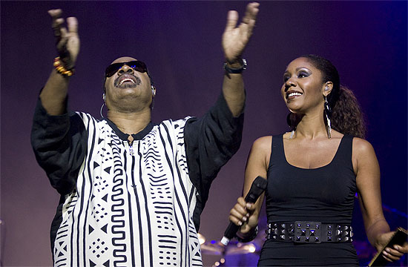
Isn't she pretty
Truly the angel's best
Boy, I'm so happy
We have been heaven blessed
I can't believe what God has done
Through us he's given life to one
But isn't she lovely made from love

Slide 6
There are people who have let the problems of today
Lead them to conclude that for them life is not the way
But every problem has an answer and if yours you cannot find
You should talk it over to Him
He'll give you peace of mind
When you feel your life's too hard
Just go have a talk with God
When your load's too much to bear
Just go talk to God He cares
When you feel your life's too hard
Just go have a talk with God
From “Have A Talk With God” – by stevie wonder

Slide 7
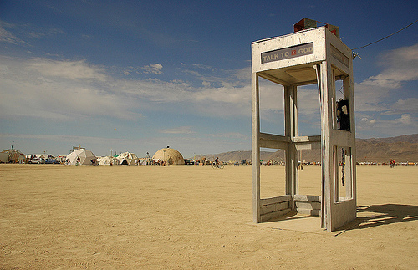

Slide 8
For by Him all things were created
things in heaven and on earth,
visible and invisible…
…He is before all things,
and in Him all things hold together.
Colossians 1: 16 & 17

Slide 9
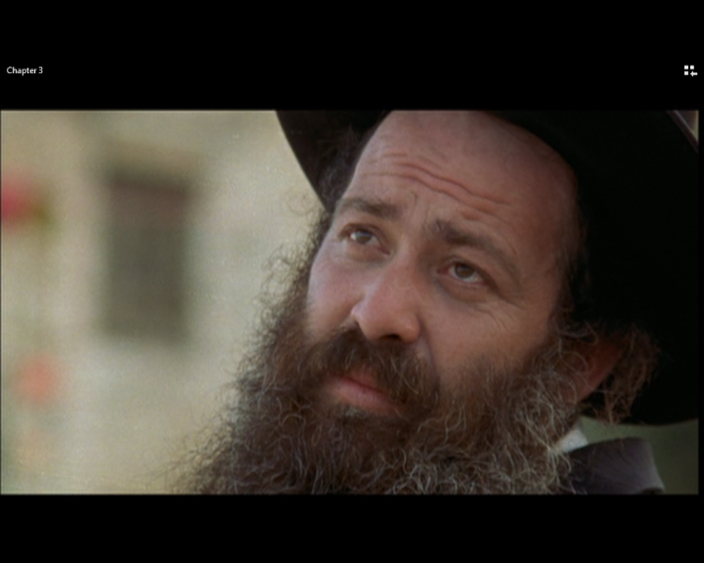
Ushpizin

Slide 10

Video clips

Slide 11
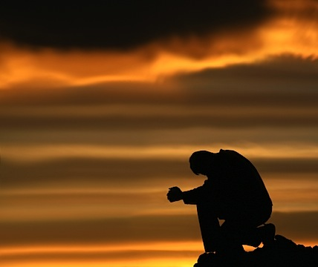

Slide 12
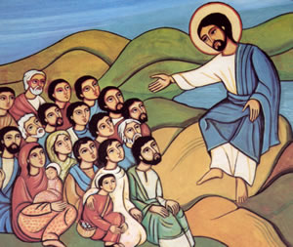
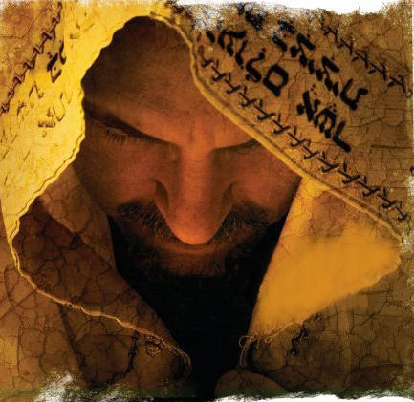

Slide 13
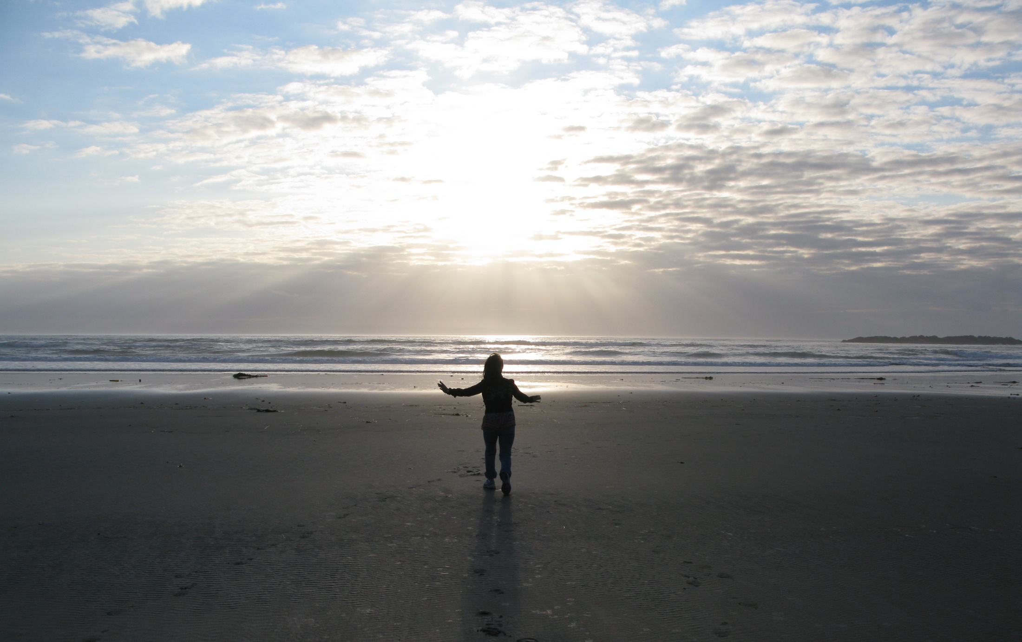
Our Father
, who art in heaven,
hallowed be Thy name.
Thy kingdom come, thy will be done,
on earth as it is in heaven.
Give us this day our daily bread;
and forgive us our debts, as we forgive our debtors;
and lead us not into temptation,
but deliver us from evil.
For thine is the kingdom
and the power
and the glory, forever.

