Slide 1
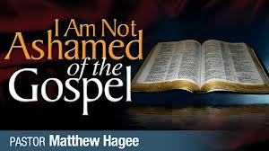
ROMANS 1:1-17

Slide 2
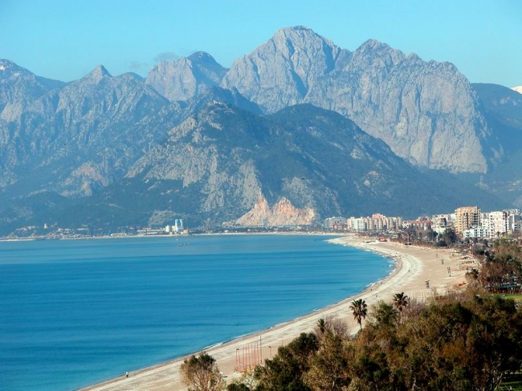
Turkey
Population: 75 million
Turkish Believers: 4.000 (Known)
Antalya
Population: 2 million
Turkish Believers: 220

Slide 3
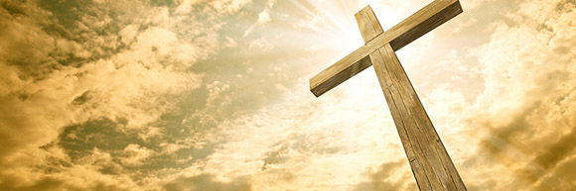
1 Corinthians 1:23
«but we preach Christ crucified: a stumbling block to Jews and foolishness to Gentiles,»

Slide 4
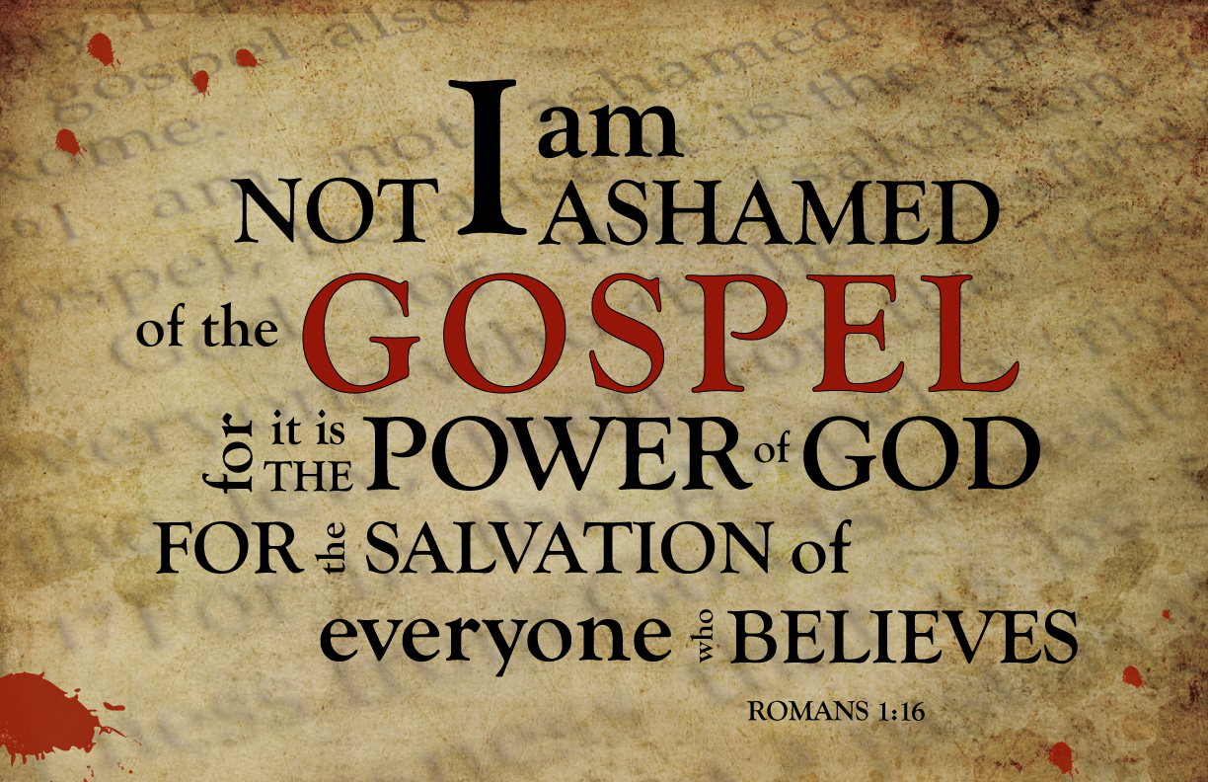

Slide 5
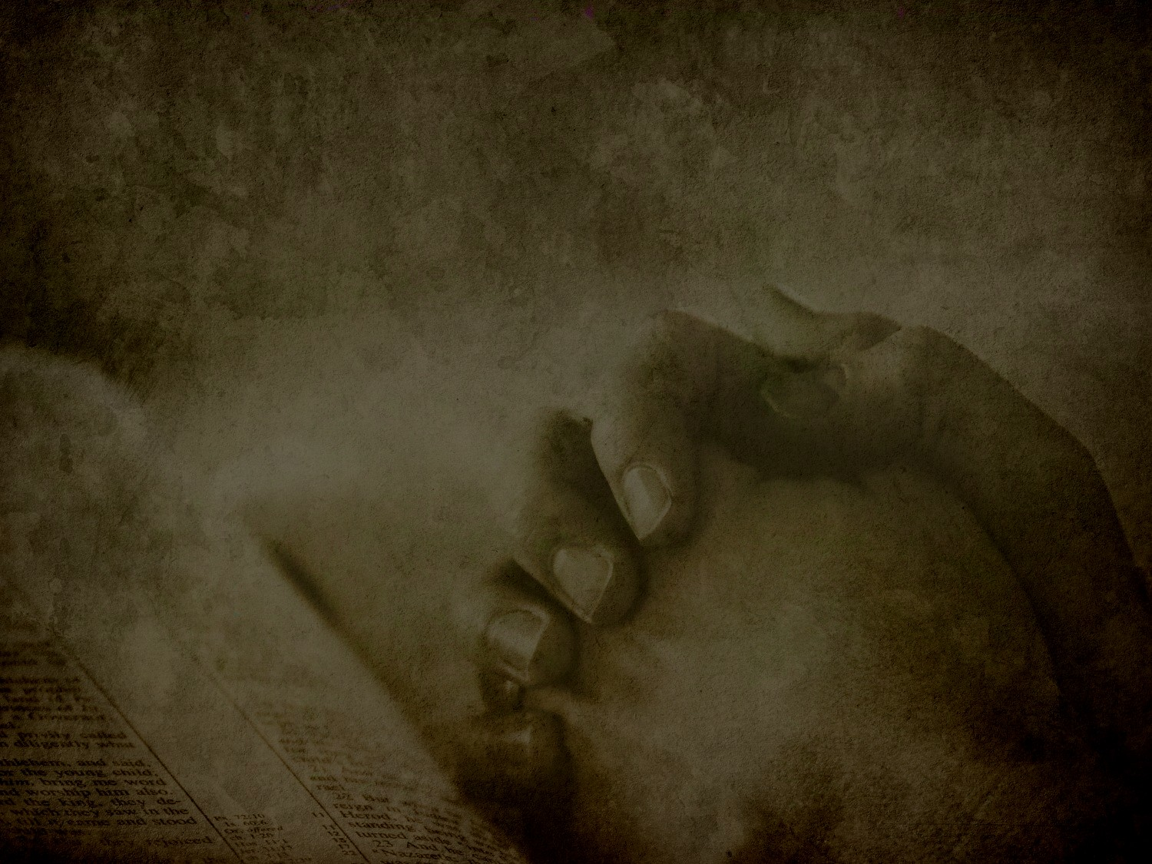
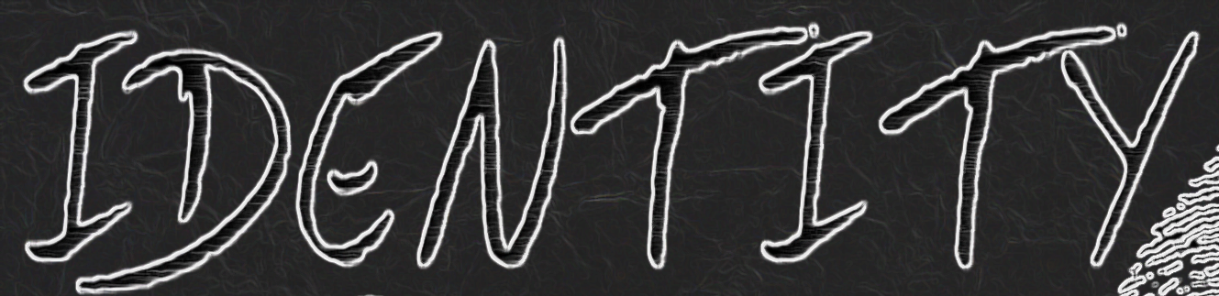
1-) We need to know who we are.
Romans 1:1-5
Paul, a servant of Christ Jesus, called to be an apostle and set apart for the gospel of God the gospel he promised beforehand through his prophets in the Holy Scriptures regarding his Son, who as to his earthly life was a descendant of David, and who through the Spirit of holiness was appointed the Son of God in power by his resurrection from the dead: Jesus Christ our Lord. Through him we received grace and apostleship to call all the Gentiles to the obedience that comes from faith for his name’s sake.

Slide 6
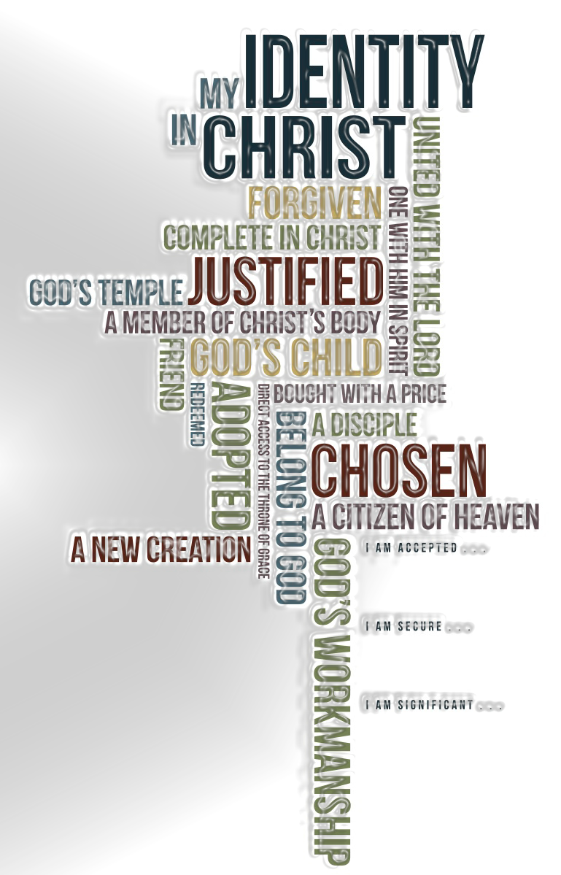
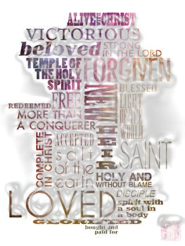

Slide 7
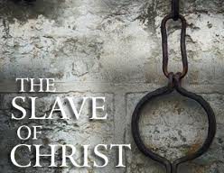

Slide 8
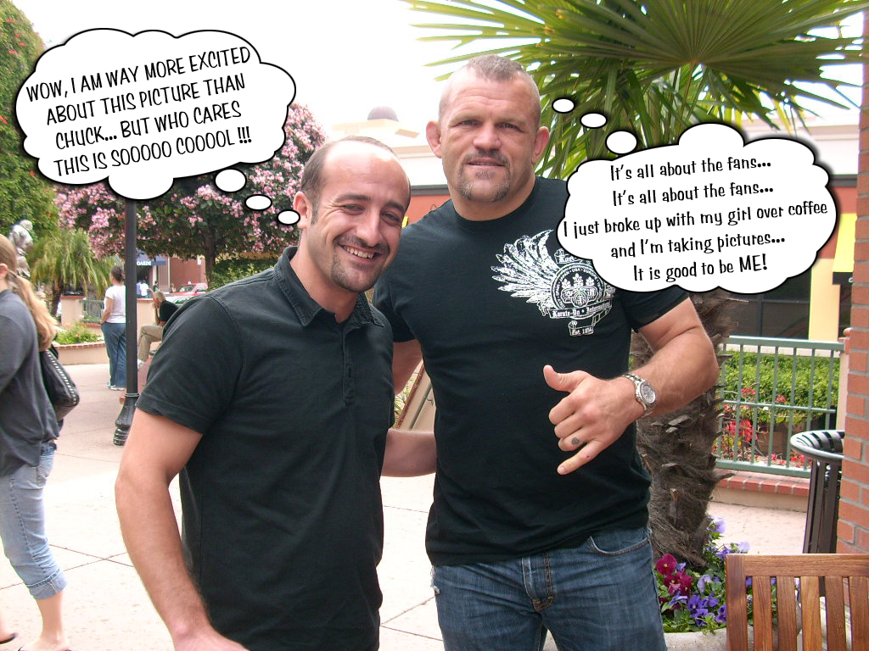

Slide 9
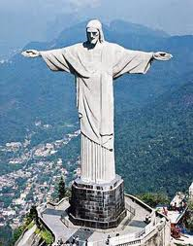
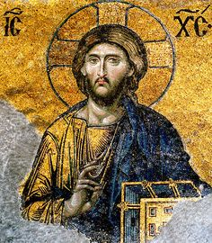

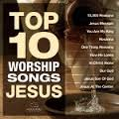
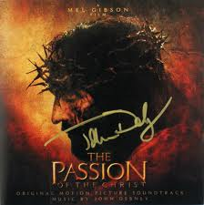
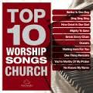


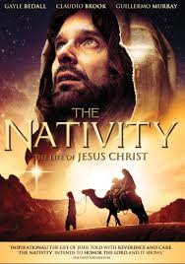
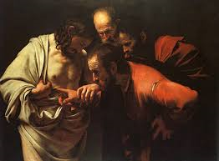
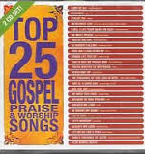

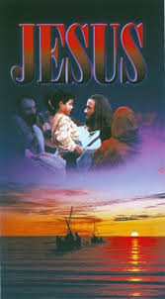
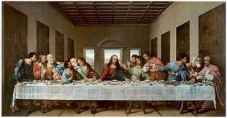

Jesus is the most famous person in our world

Slide 10
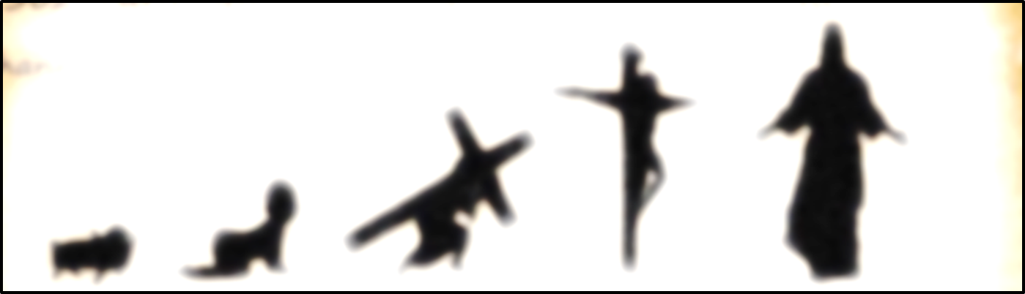
2-) We need to know what we believe.
Romans 1:2-4
The gospel he promised beforehand through his prophets in the Holy Scriptures regarding his Son, who as to his earthly life was a descendant of David, and who through the Spirit of holiness was appointed the Son of God in power by his resurrection from the dead: Jesus Christ our Lord.

Slide 11
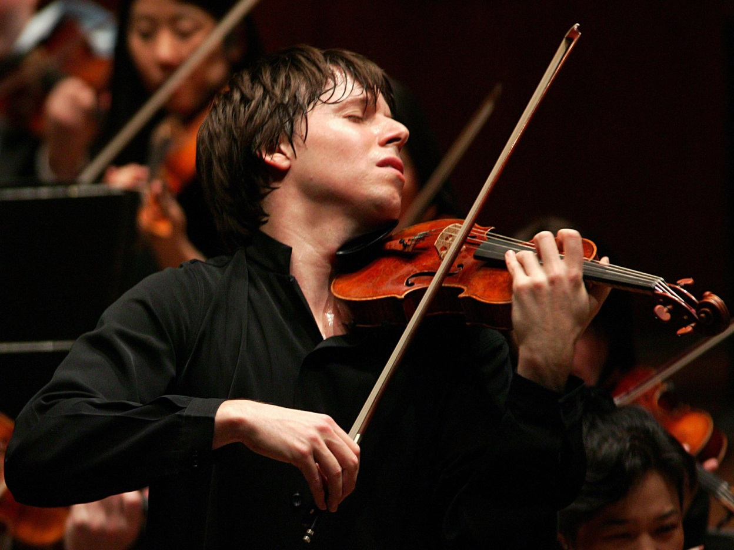
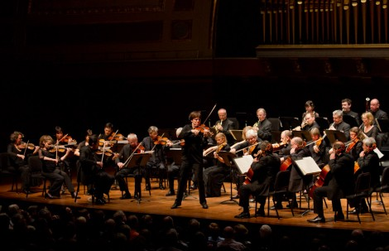

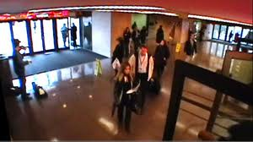
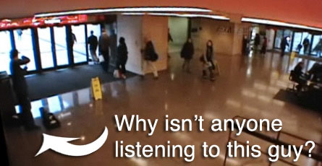

Slide 12
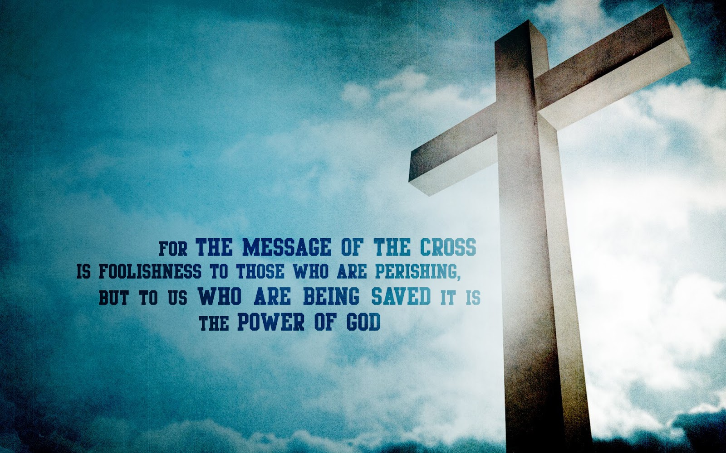


Slide 13
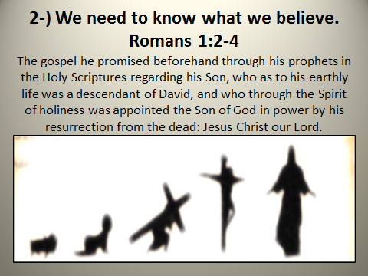

Slide 14
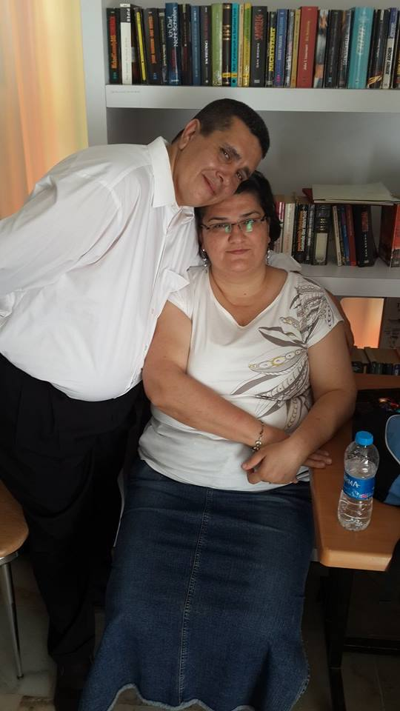
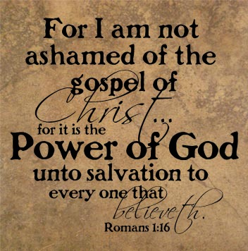

Slide 15
3-) We need to know why we are here.
Romans 1:5 "Through him we received grace and apostleship. To call all the Gentiles to the obedience that comes from faith."
Galatians 1:15-16 "God who called me by His grace, was pleased to reveal His Son in me so that I might preach Him among the nations."
Romans 15:8-9 "Christ came to give His life so that the nations might glorify God for His mercy."
Romans 1: 14-17 I am obligated both to Greeks and non-Greeks, both to the wise and the foolish. That is why I am so eager to preach the gospel also to you who are in Rome. For I am not ashamed of the gospel, because it is the power of God that brings salvation to everyone who believes: first to the Jew, then to the Gentile. For in the gospel the righteousness of God is revealed a righteousness that is by faith from first to last, just as it is written: "The righteous will live by faith."

Slide 16
Our Church's Mission Statement:
• Our faith is in Jesus Christ and we desire to glorify God in our lives.
• We strive for spiritual growth as a church and aim to equip each member of our body to serve the community.
• We proclaim the Gospel of Jesus Christ to those who have never heard it.
• We strive to make disciples.
• We aim to plant new churches in places and cities where there are none.
• We aspire to reflect the character of Jesus to the people around us, to the nation of Turkey and to the rest of the world.

Slide 17
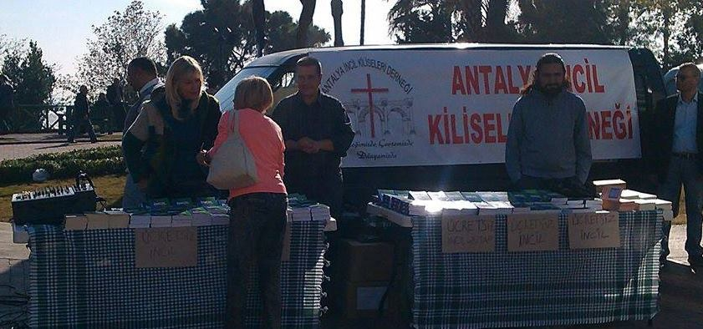
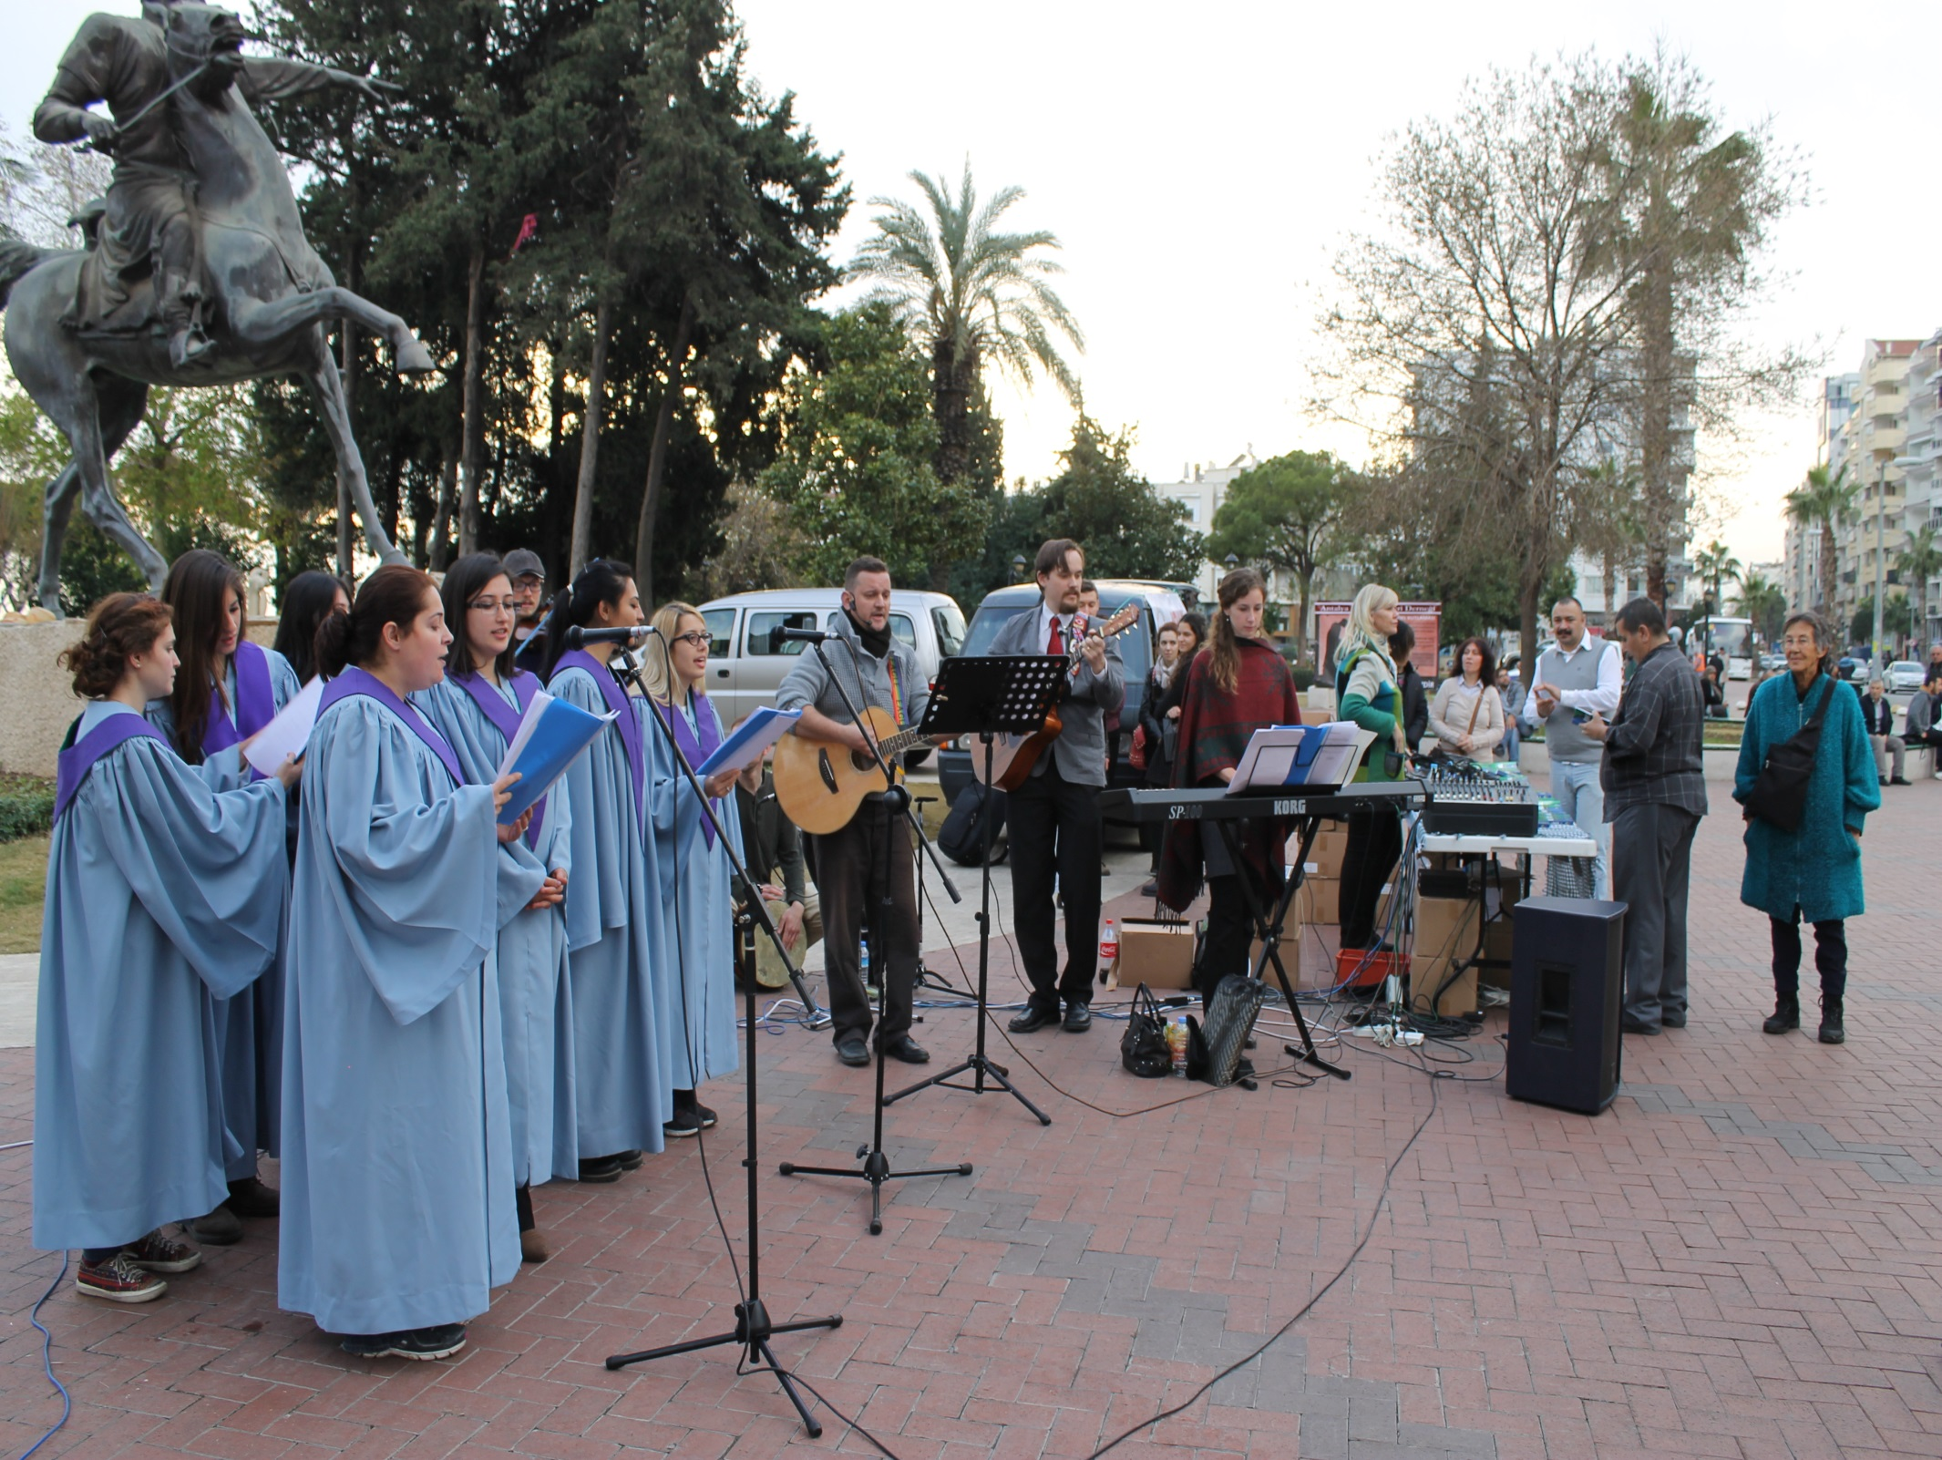
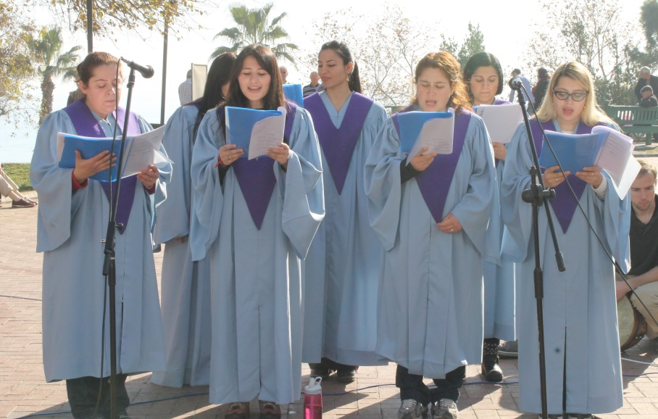

Slide 18
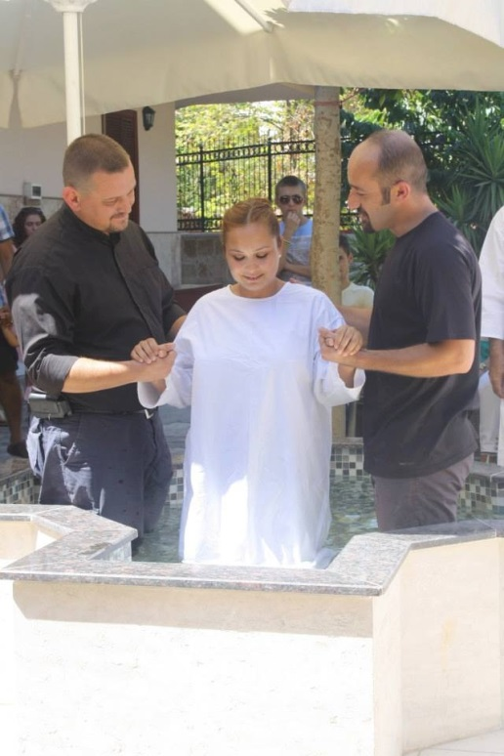
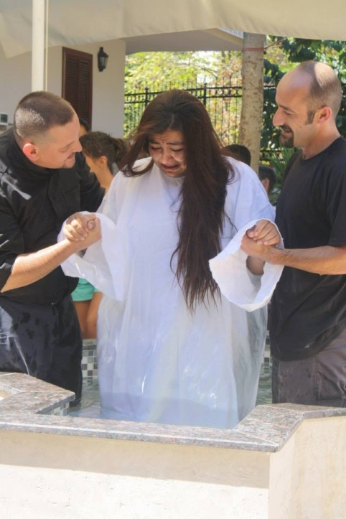
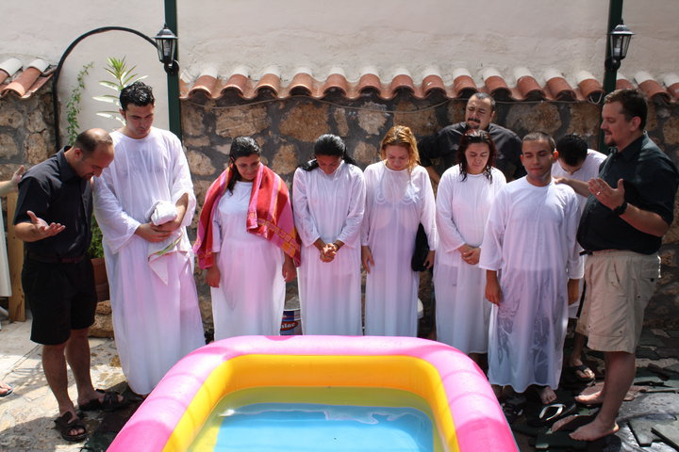
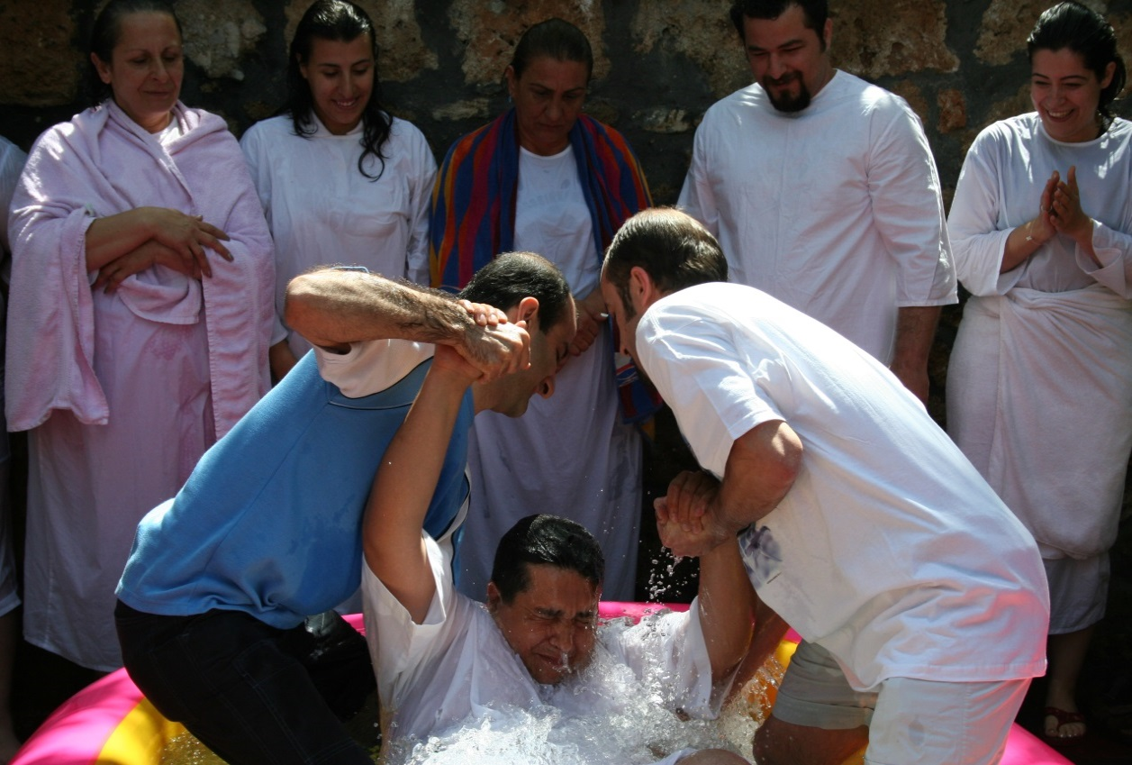
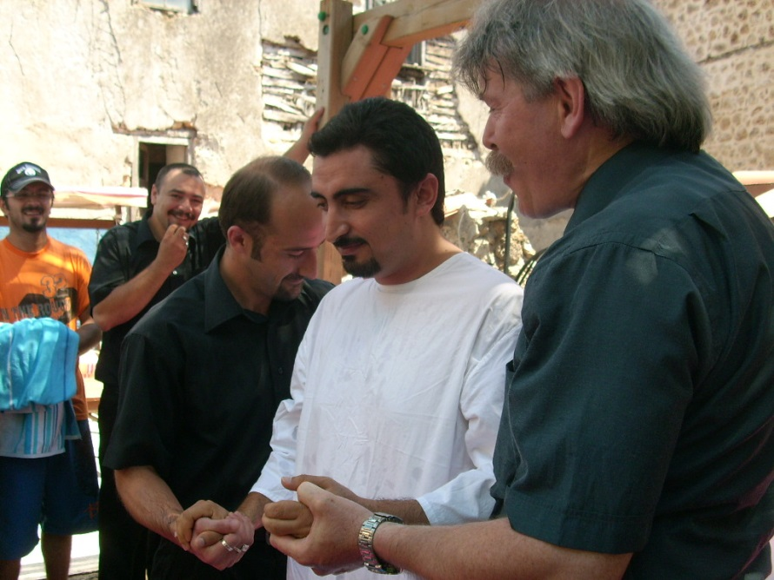

Slide 19
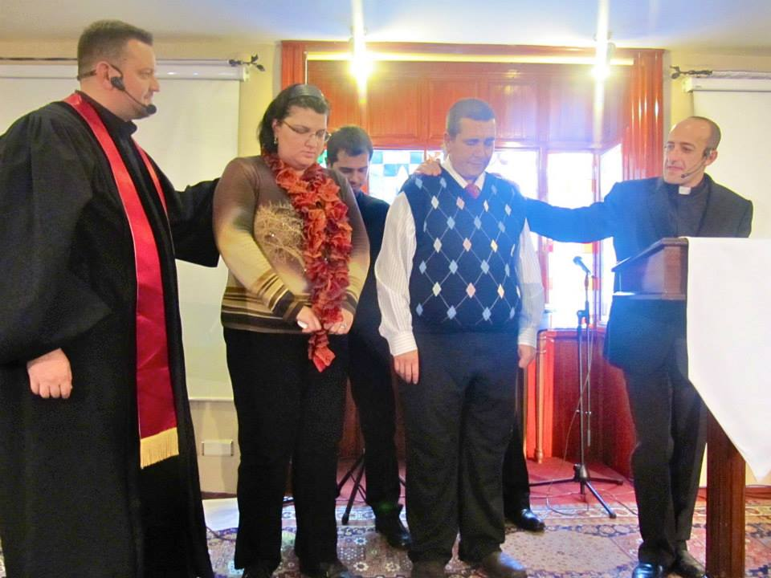
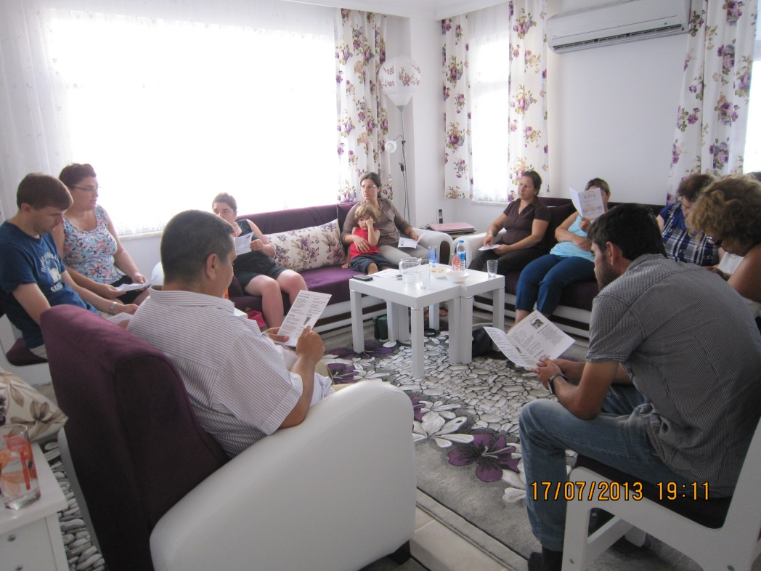
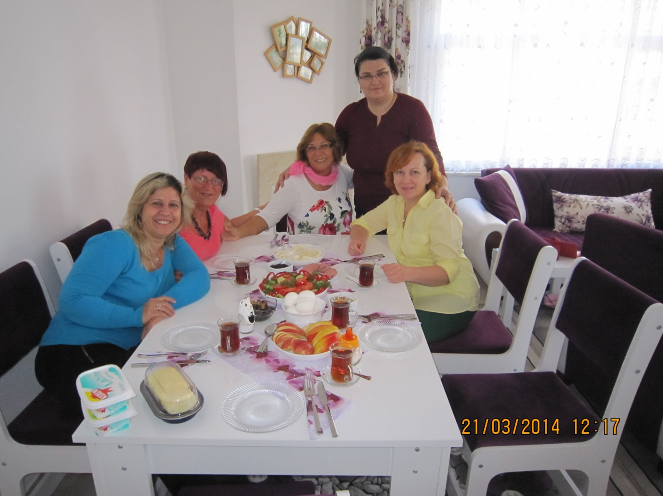
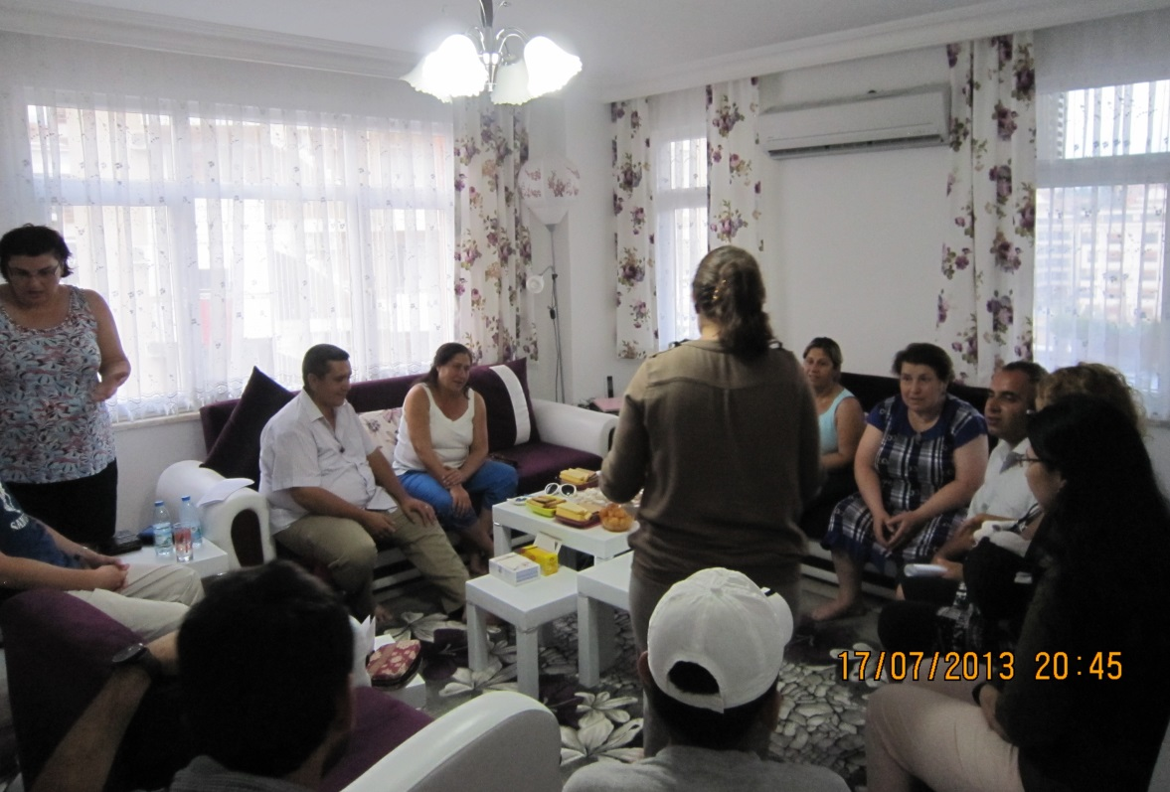

Slide 20
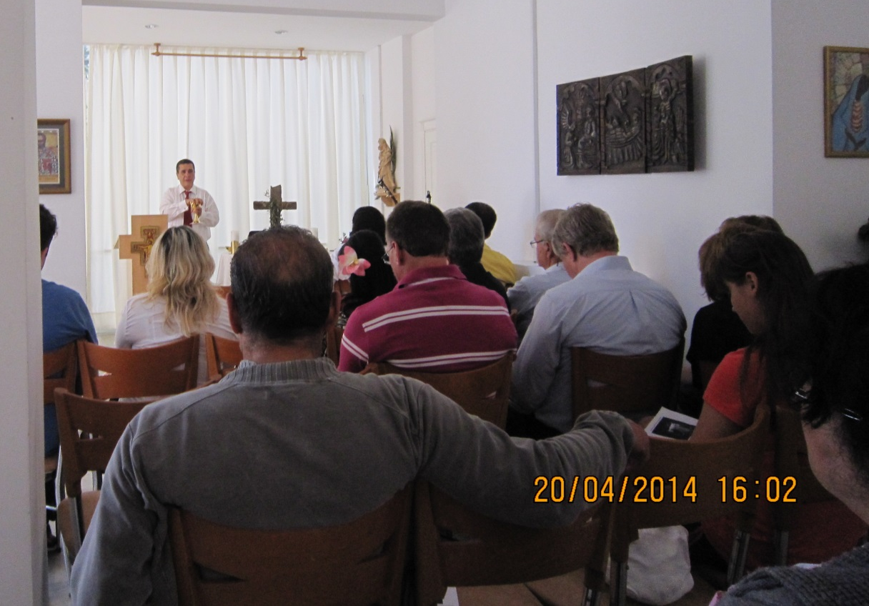
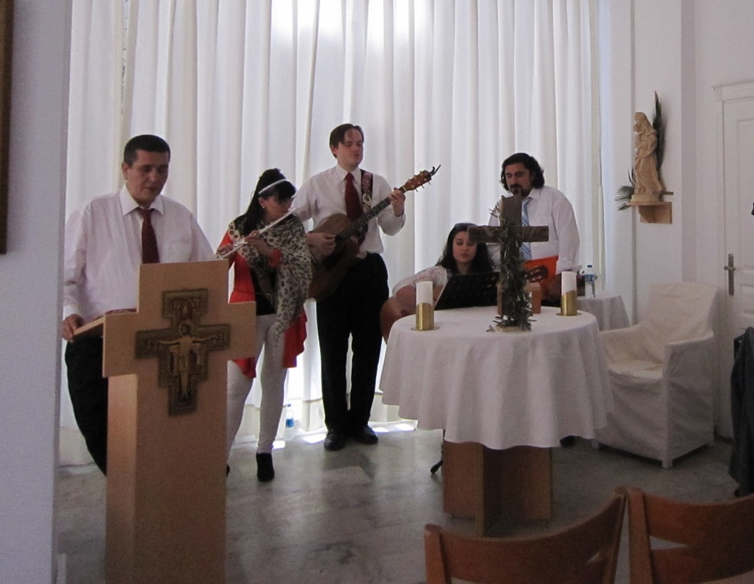
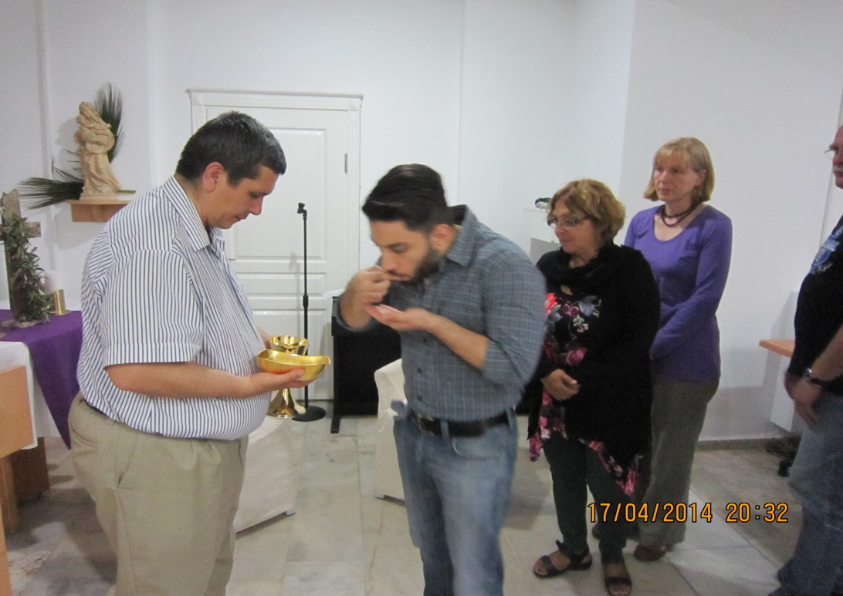
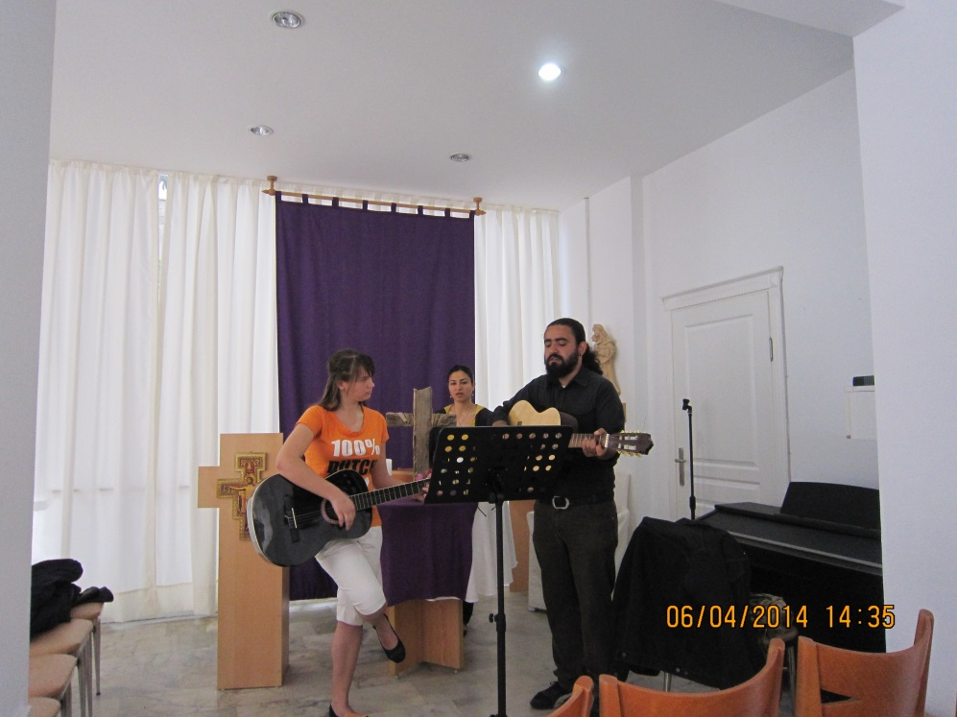

Slide 21
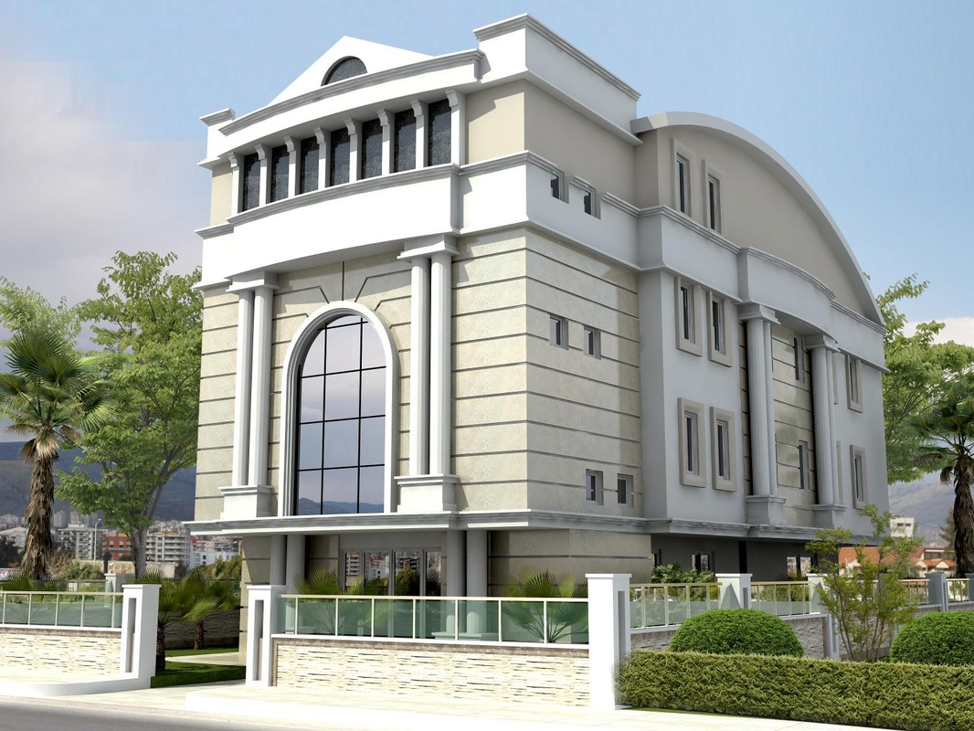

Slide 22
